Slide 1


Robotic Sorting System ECEN 403 Final Presentation Pace Dominy, Joseph Miller, Lam Tran

Slide 2
Project Description
Sorting fruit by hand can be tedious and expensive.
The Robotic Sorting System is an automatic sorting system that requires limited manpower/oversight that can accurately sort fruit by their size and quality without the user having to do it themselves.
Notes:
Sorting fruit by hand can be tedious and expensive
The Robotic Sorting System provides a relatively inexpensive way to accomplish the task
It optically scans the fruit to determine its size and color
Then puts it in a bin as specified by the machine configuration
It’s particularly useful for cost-limited or near-end-user applications where you don’t want/can’t afford something huge and expensive.

Slide 3
System Diagram
Maroon arrows denote physical inputs and outputs
Operator Input
Fruits
Android Application
System Status
Conveyor Belt
Joseph Miller
Sorting Configuration
Control
Sensors
Data
Raspberry Pi
Fruits
Data
Robotic Levers
Fruit Receptacles
Lam Tran
Power Control
Provides power to all subsystems except Android application
Pace Dominy
Pace Dominy
Wall Power
Notes:
All configuration and system status is displayed via an Android application
The sensors and Android app connect to a Raspberry Pi that pushes configuration to the robotic levers
Wall power is standard U.S. 120V 60Hz mains power

Slide 4
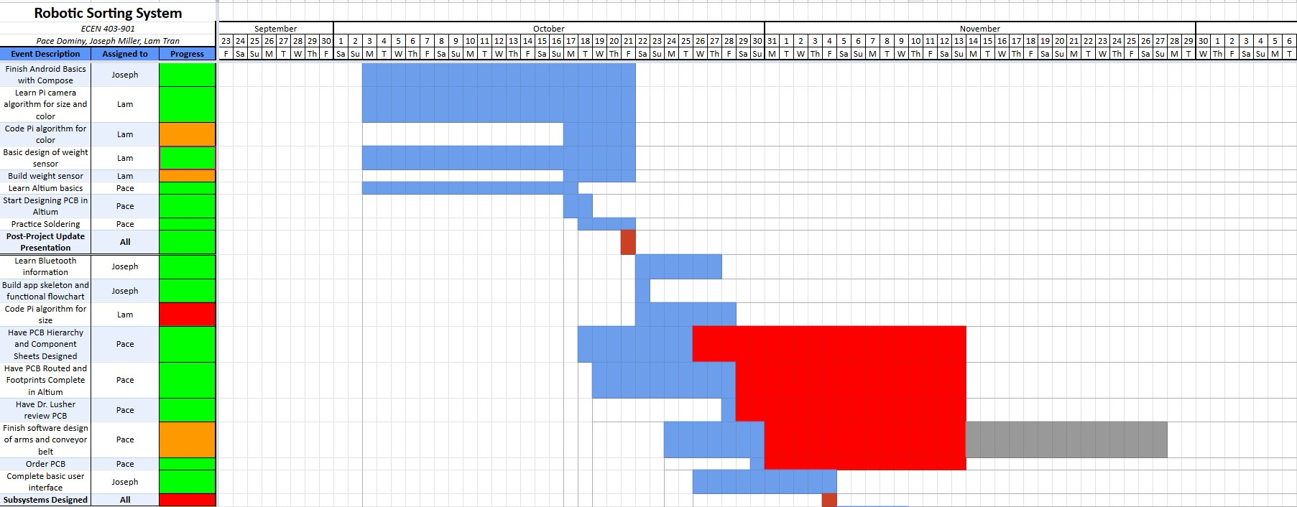
Schedule: Recent Progress
Notes:
At this point in the semester, our research and basic familiarization is complete and we’ve designed our subsystems
This looks different for each subsystem, but in general, we have at least prototype physical versions of our subsystems

Slide 5
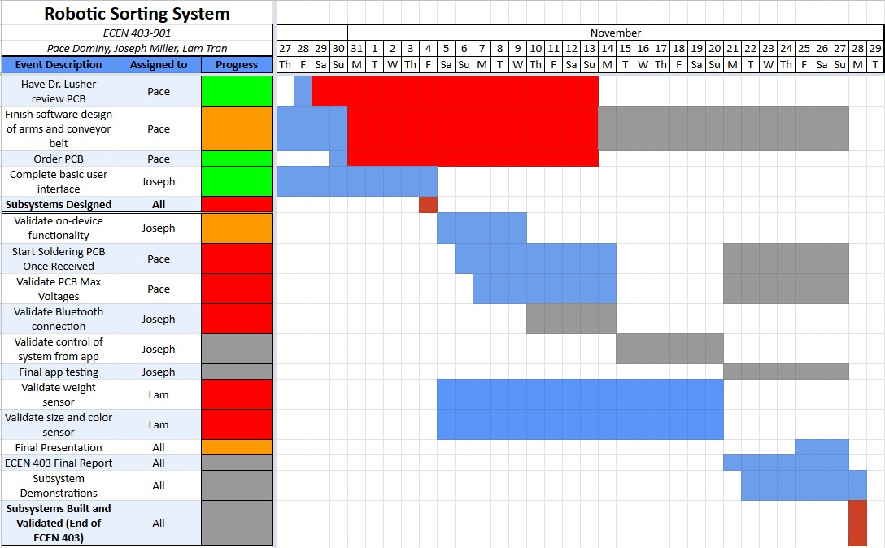
Schedule: Looking Forward
Notes:
Going forward, we’re finalizing the design of our subsystems and formally validating them
You’ll notice some red where some of these tasks are a bit behind schedule, but we planned in some extra room at the end of the semester for these, so things are under control

Slide 6
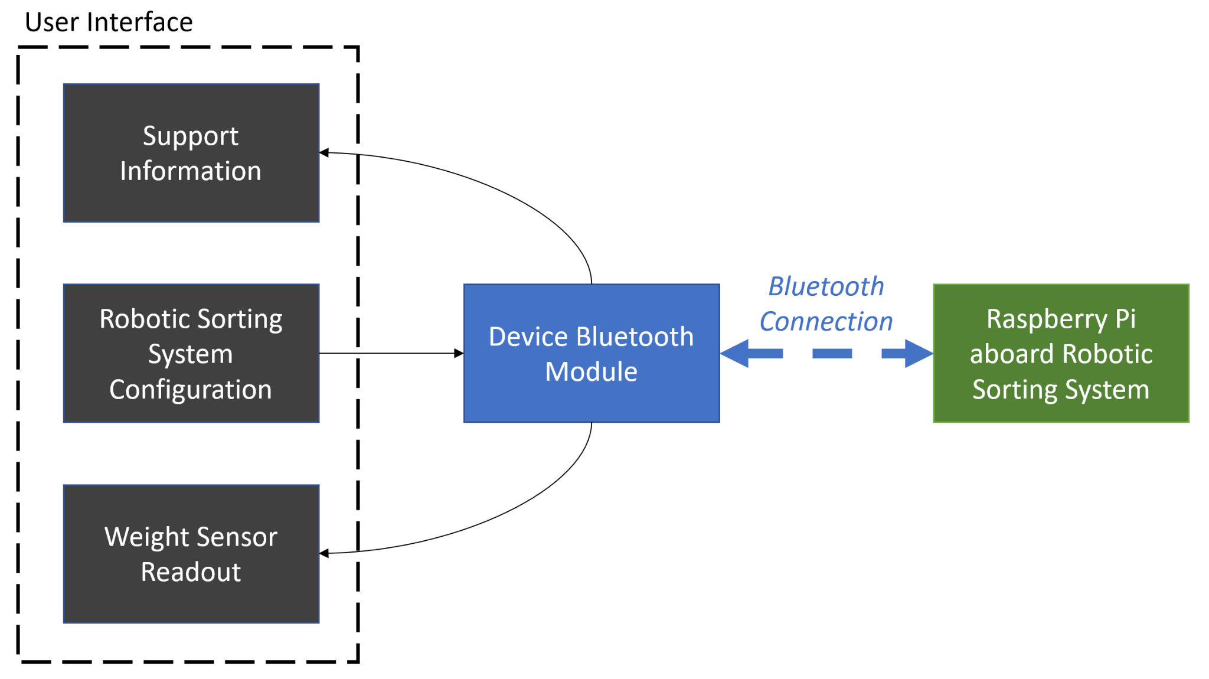
Android Application - Joseph
Engineering Design Accomplishments (ECEN 403)
Introduction to the Kotlin language and Android Studio
Implementation of basic interface features with Jetpack Compose
Structure of Material Design-compliant user interfaces
Navigation between screens using Jetpack Compose interface features
Created a Github repository for version control
To be completed (ECEN 403)
To be completed (ECEN 404)
Notes:
Best to frame the technical accomplishments in my overall plan for the subsystem - this is an annotated version of my subsystem block diagram from the Project Update Presentation
The majority of work this semester has been in basic familiarization with Kotlin and Android Studio, then using it to build a user interface
As a whole, I’ve used official Google tutorials to understand the Kotlin language, the Android Studio IDE (which is like PyCharm from ENGR 102), and the Material Design language that Google encourages for use in Android apps
Part of that was learning the “philosophy” of the Jetpack Compose toolkit that Google uses to make things more straightforward
Basically has units called “composables” that correspond to UI elements like buttons - and ways to arrange them and rows in columns
The point of mentioning all of this is that learning these things took a while, but once I had a decent handle on them, I was able to develop the app very quickly
Slightly more advanced topics: navigation between screens and Bluetooth
Currently, I can move between screens by pressing buttons. Forming a Bluetooth connection will come later…

Slide 7
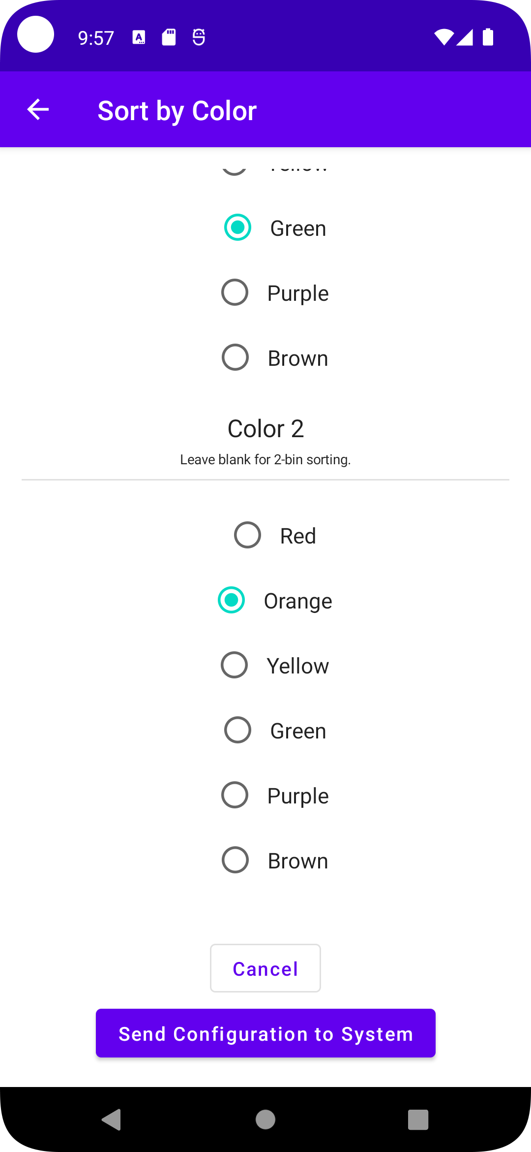
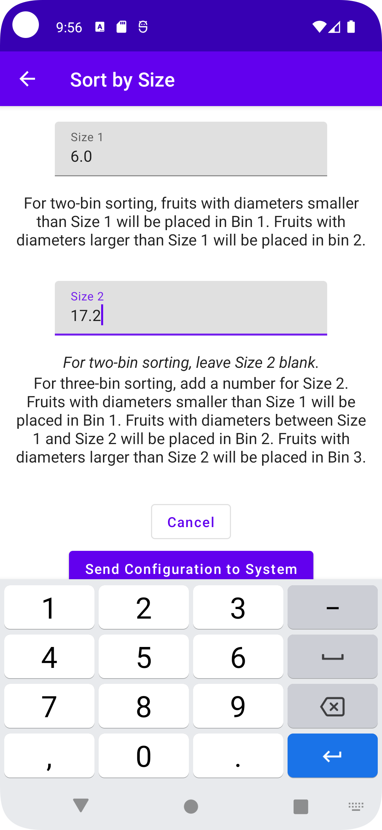
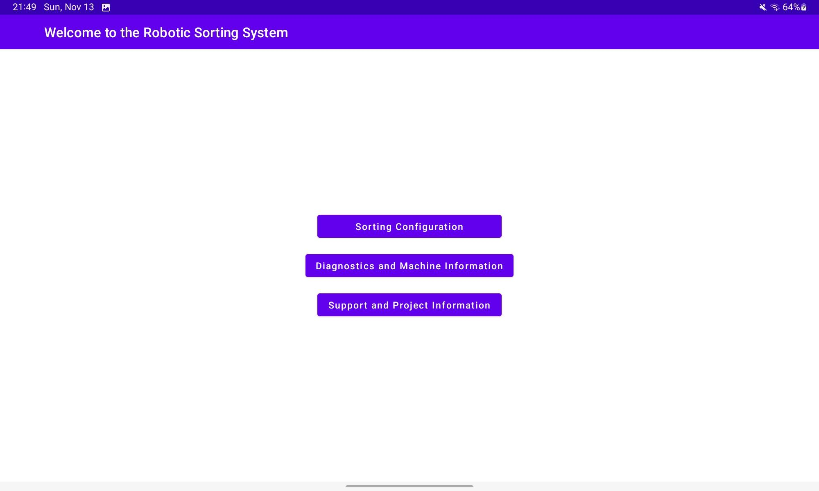
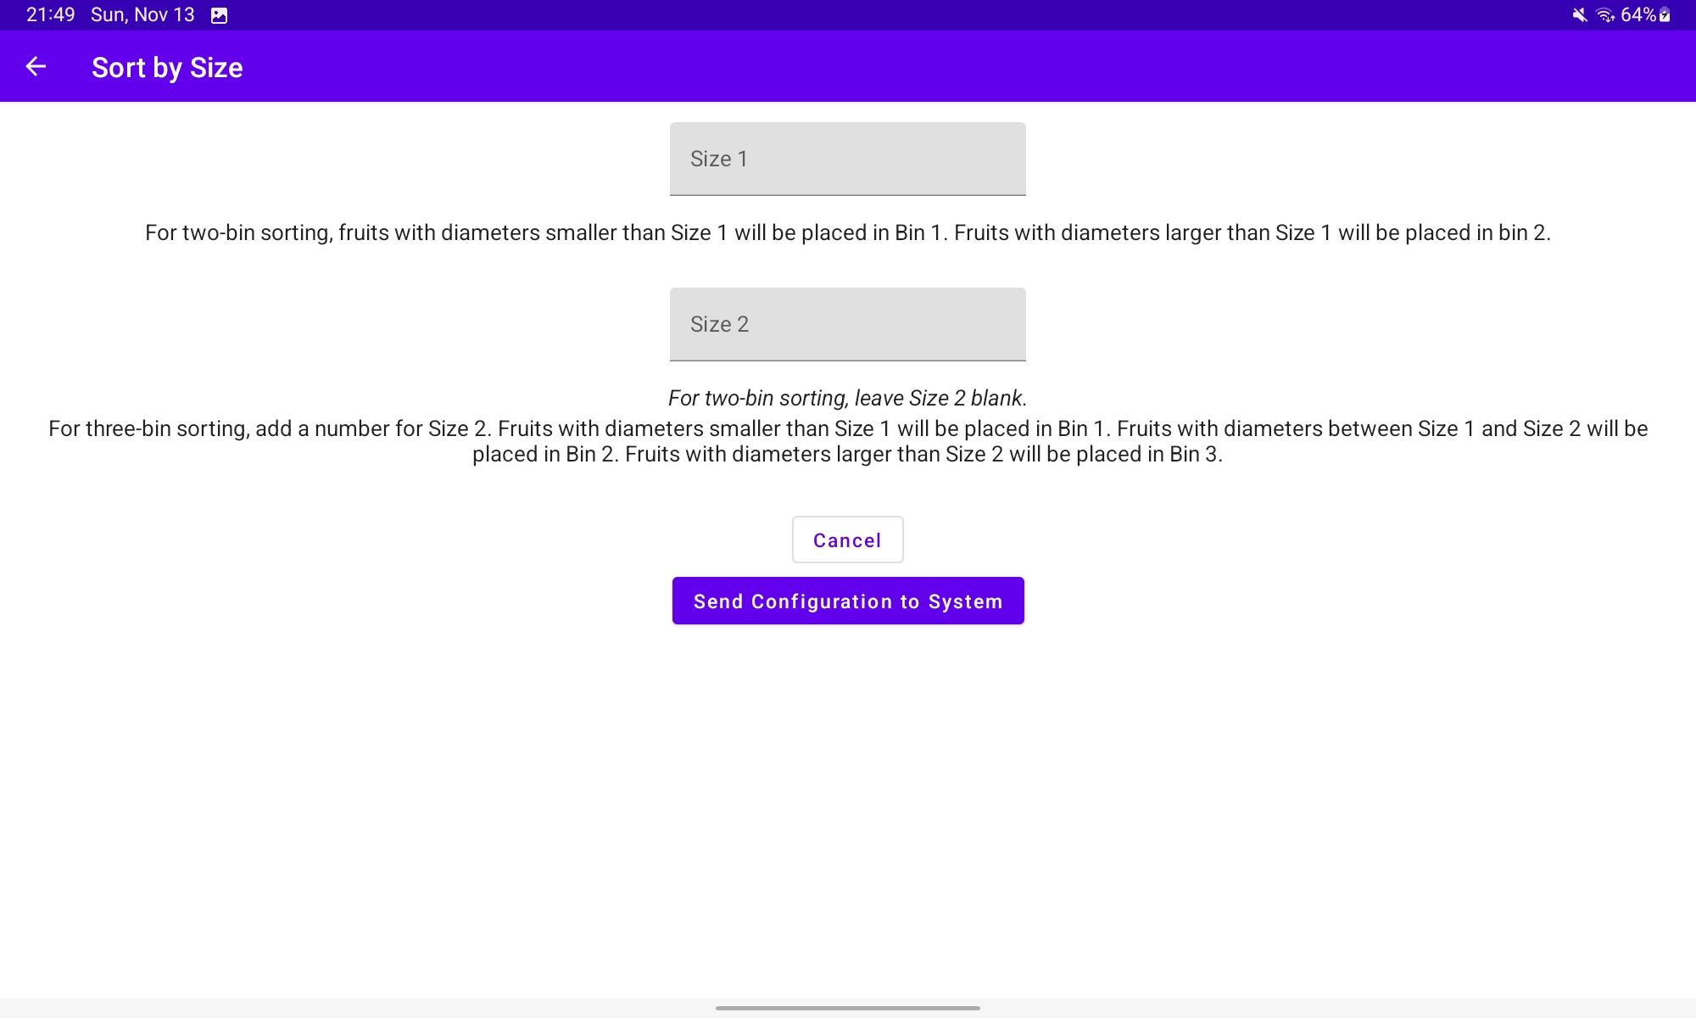
Android Application - Joseph
Engineering Design Accomplishments (ECEN 403)
Notes:
All screens have been implemented - these are a selection that show the key features that have been implemented
Right pics are from my personal Android tablet, a Samsung Galaxy Tab S6 Lite running Android 12.0
I don’t have an Android phone, so left pics are from a Google Pixel 5 running Android 12.0 as emulated in Android Studio
On the far left, you’ll notice the functional radio buttons and “Cancel” and “Send Configuration to System” buttons
The Send Configuration button is a placeholder, but everything else on screen is functional
On the Size screen, you can put in custom values using the keyboard
On the right side, you’ll see the initial screen. Note there’s no back arrow in the top bar because this is the initial screen. The app only displays the back arrow when you can actually go back
Bottom left is the same Sort by Size screen - notice how the layout works equally well on the narrow phone and wide horizontal tablet displays
If you’ve used an Android device for a while, you’ll notice the Material Design traits in the top bar and in the colors
Will continue theming later

Slide 8
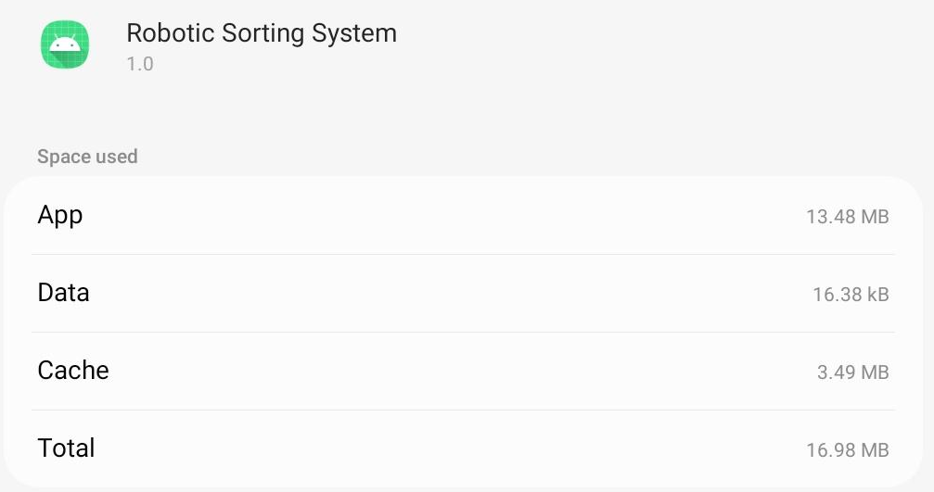
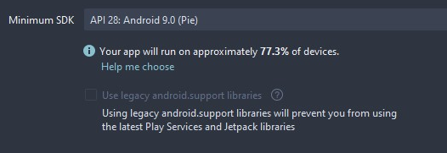
Android Application - Joseph
Execution and Validation Status
Subsystem FSR Item | Title | Status
3.2.1.1 | Android Version Compatibility | Completed (Targets API version 32, minimum API 28)
3.2.1.2 | Device Form Factor Compatibility | Completed (Tablets and Smartphones)
3.2.1.3 | Programming Language and Development Environment | Completed (Kotlin in Android Studio)
3.2.2.1 | Physical Size | Completed (16.98 MB)
Notes:
These requirements come from the Android Subsystem FSR
Android Version Compatibility: was able to make it with a target API of 32 (Android 12.0) and minimum API of 28 (Android 9.0)
Note the screenshot from Android Studio on the bottom left: this allows the application to run on ~77.3% of all Android devices
Strikes a good balance between modern features and older device compatibility
Form Factor Compatibility: as seen on previous slides, the app adapts itself to fit on both smartphones and tablets
Programming Language and Environment: uses Google-endorsed Kotlin/Jetpack Compose in Android Studio
Physical Size: The app comes in at 16.98 MB so far, which is below the target of 30 MB with plenty of room to grow as features are added
This target makes it half the size of most popular Android apps

Slide 9
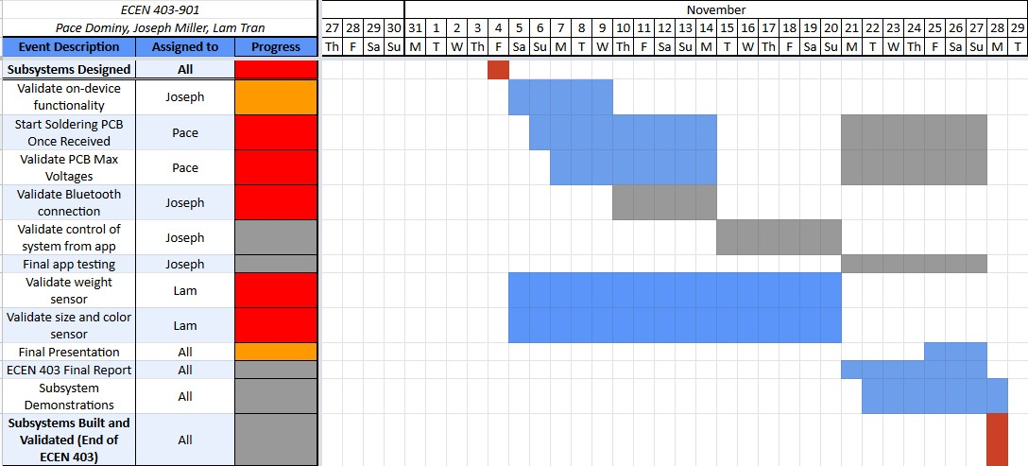
Android Application - Joseph
Execution and Validation Status
Execution Points Completed
Milestone 1 (FSRs/ICDs)
Midterm Presentation finished, Project and Subsystem FSR/ICDs written
Milestone 2 (Post-Midterm)
Android Basics course finished, Bluetooth information learned, app skeleton/flowchart built, basic user interface completed
Upcoming: formal validation tasks
Notes:
This shows the validation plan for the rest of the semester and going into 404.
All execution tasks have already been completed for the Android app subsystem except for basic Bluetooth functionality
In between now, the existing application will be validated using the testing mechanism in Android Studio

Slide 10
Android Application - Joseph
Remaining Tasks for ECEN 403 and 404
Approximate hours of work since Project Update Presentation: 38
Tasks to be completed for Subsystem Demonstrations, November 28th
Implementation of basic Bluetooth functionality
Automatic test-based validation of the following:
Intended user experience
Bluetooth connection basics
Tasks to be completed by the end of the Fall 2022 semester
ECEN 403 Final Report
Tasks to be completed in the Spring 2023 semester (ECEN 404)
Data transfer with Raspberry Pi
Generation of System-readable configurations
Improve appearance of the application
Notes:
For subsystem demonstrations, I’ll be demonstrating the ability for the application to use the device to connect to my personal Raspberry Pi via Bluetooth
I’ll also use Android Studio’s automated test function (tests written by me by hand) to ensure the intended user experience
aka that a user can’t break the app by pressing a certain combination of buttons at the wrong time
I’ll also ensure that the Bluetooth connection is stable and that the devices “remember” each other
By the end of 403, we’ll write the final report
In 404, I’ll focus on data transfer between the app and the Pi
This will require me to store and send the configuration to the RSS along with receiving and displaying diagnostic info
Finally, I’ll take the time to make the application as polished and professional-looking as possible using Material Design guidelines

Slide 11
Engineering Design Accomplishments - Pace
Average Weekly Hours: 10
Selected electrical components for Power Subsystem, Conveyor Belt and Robotic Levers
Designed PCB for the electrical components to be placed on or connected to
Learned Soldering of various surface mount components such as 0805 and ICs

Slide 12
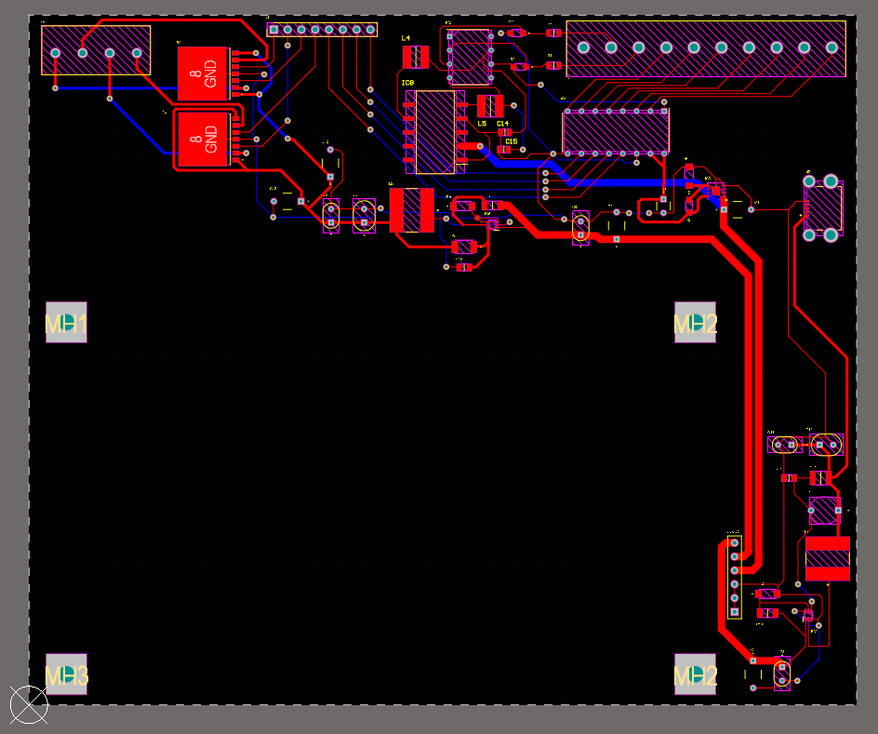
Engineering Design Accomplishments - PCB

Slide 13
PCB Validation Status
Power Subsystem meets Power FSR requirements
Power FSR Functional Requirements 3.2.1
Designed to supply power to all subsystems without damaging them
Power FSR Physical Characteristics 3.2.2
Mass and Volume meet Robotic Sorting System FSR Requirements, less than 10 lbs and fits within volume constraints of Robotic Sorting System FSR 3.2.2.2
Power FSR Electrical Characteristics 3.2.3
PCB takes 120 VAC 15 A input from wall output. Power output for Raspberry Pi 4B designed in order to not damage the Raspberry Pi 4B

Slide 14
Remaining Tasks - Pace
To Be Completed (ECEN 403)
Design conveyor belt and robotic levers in cad
Solder the PCB once received
Test and validate the PCB’s functionality
Design mount for PCB and DC motors
Program, test and validate PWM for DC motors
To Be Completed (ECEN 404)
Fabricate and assemble conveyor belt and robotic arms
3D print mounts for PCB and motors
Test and validate conveyor belt and robotic arms subsystems
Notes:
TB6612FNG dual h-bridge

Slide 15
Engineering Design Accomplishment - Lam
Average Weekly Hours: 6.75 hours
Selected electrical component for weight sensor
Built the frame for the weight sensor
Familiarized with the OpenCV library
Implement a simple color detection algorithm
Created a Github repository

Slide 16
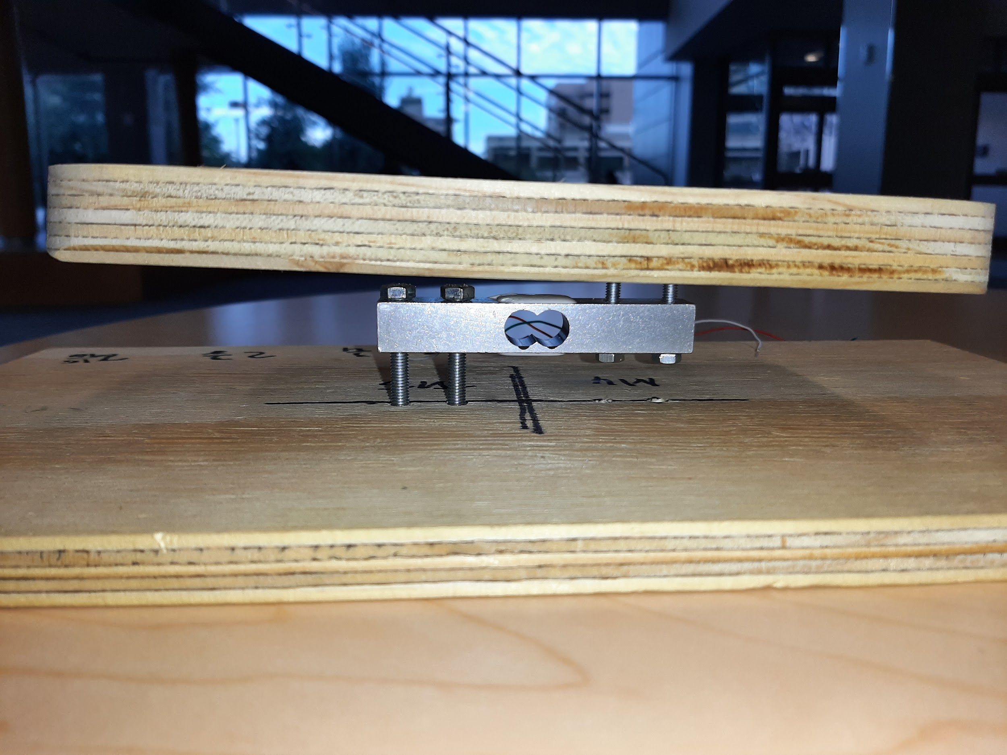
Weight Sensor

Slide 17
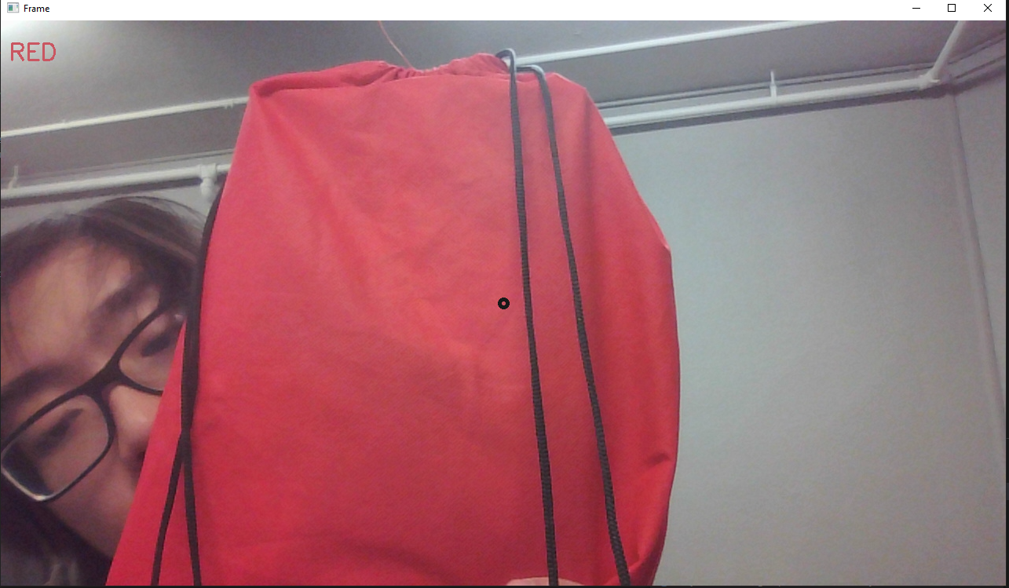
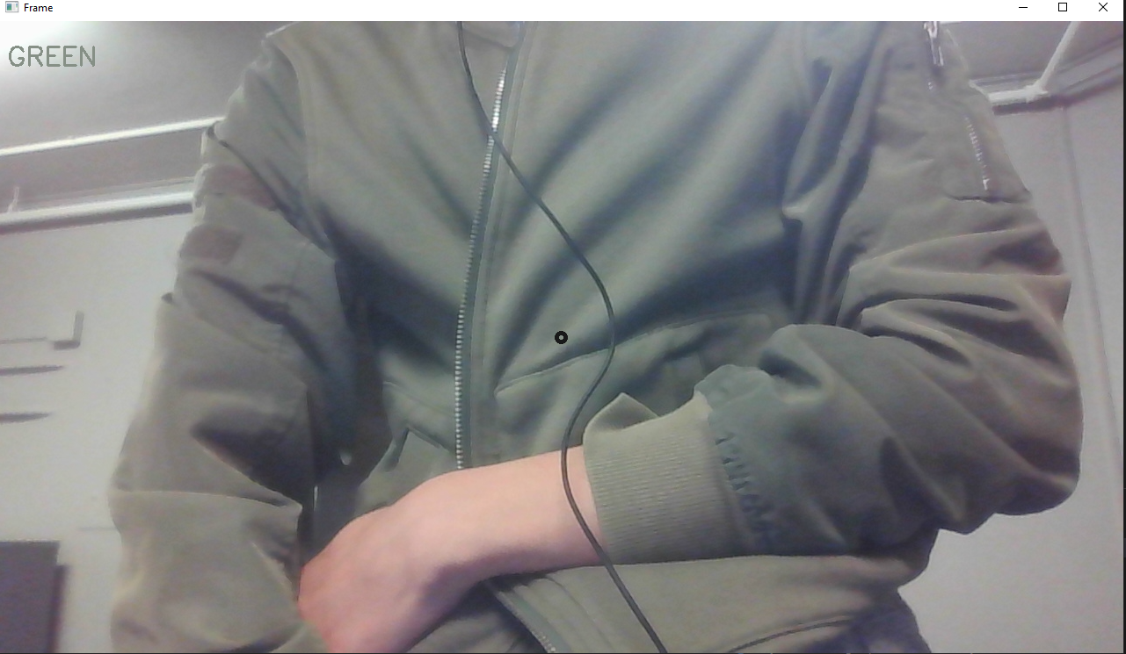
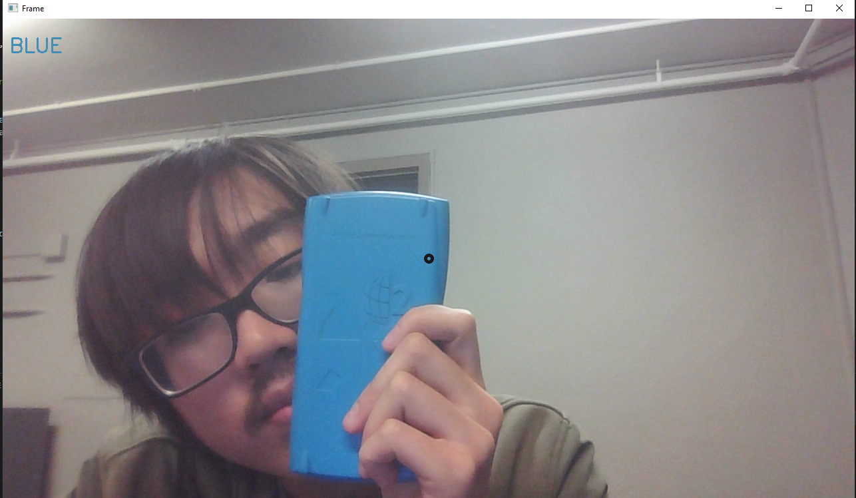
Color Sensor

Slide 18
Sensor Validations Status
Sensor Subsystem that meets Sensor FSR requirement
3.2.1 Functional / Performance Requirements
The code for the color sensor and size sensor will be written in Python with OpenCV library
3.2.3 Sensor FSR Electrical Characteristic
The input voltage level for the sensors shall be +3.3 VDC to +5 VDC.

Slide 19
Remaining Tasks
To be completed (ECEN 403)
Implement motion tracking to the color sensor
Connect the weight sensor to the Raspberry Pi with ADC
Test and validate weight sensor
Program the size sensor
Import python programs to the Raspberry Pi
Test and validate the color sensor and size sensor
To be completed (ECEN 404)
Integrate all the sensor subsystems with the other subsystems

